Slide 1
Using Shazam

Slide 2
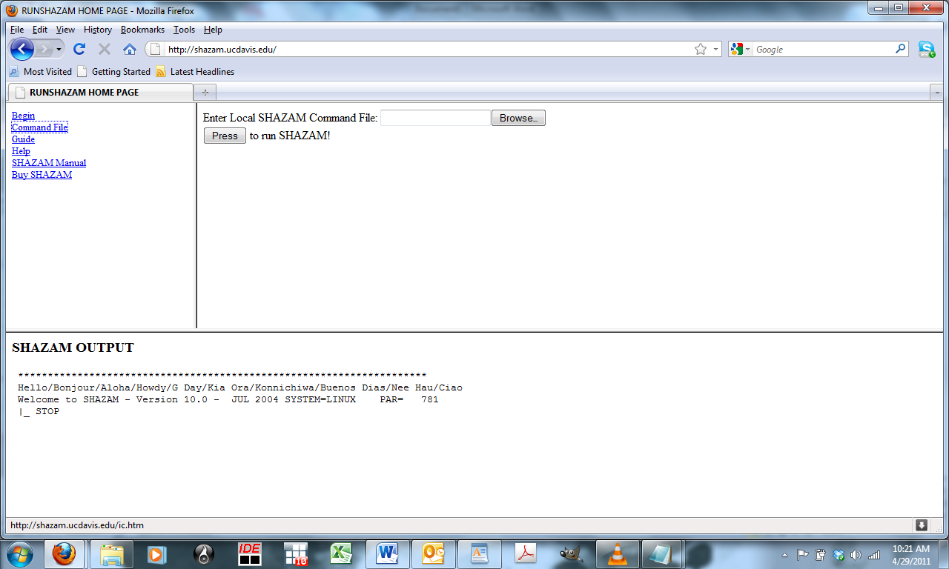
Step 1: Go to Shazam.ucdavis.edu
Click on “Command File”

Slide 3
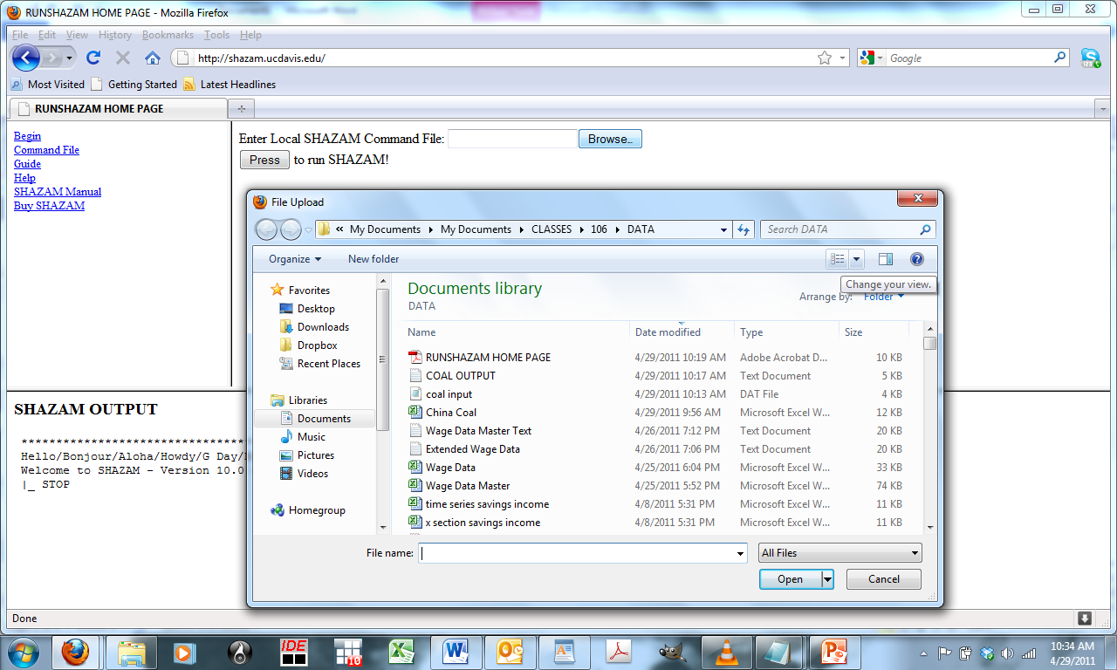
Step 2: Use Browser to Tell Shazam Where your Command File Is

Slide 4
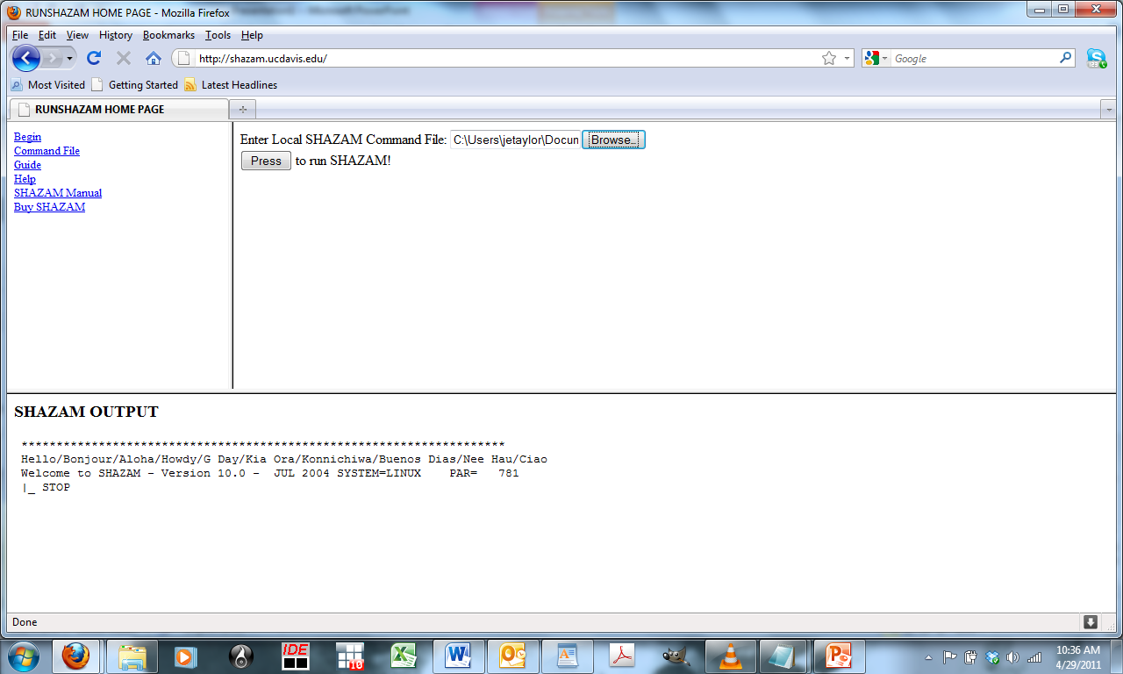
Step 3: Run Shazam!

Slide 5
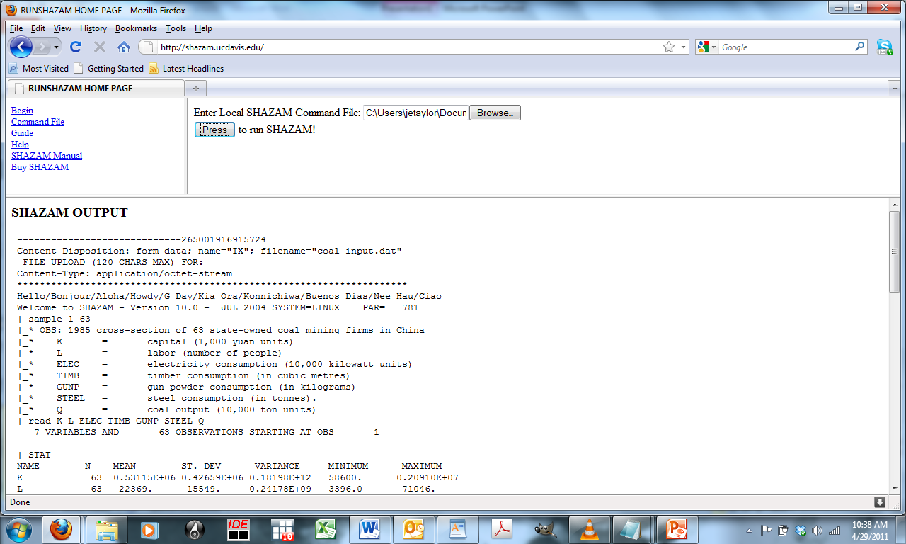
Step 4: Check Your Output
Scroll Down

